Slide 1
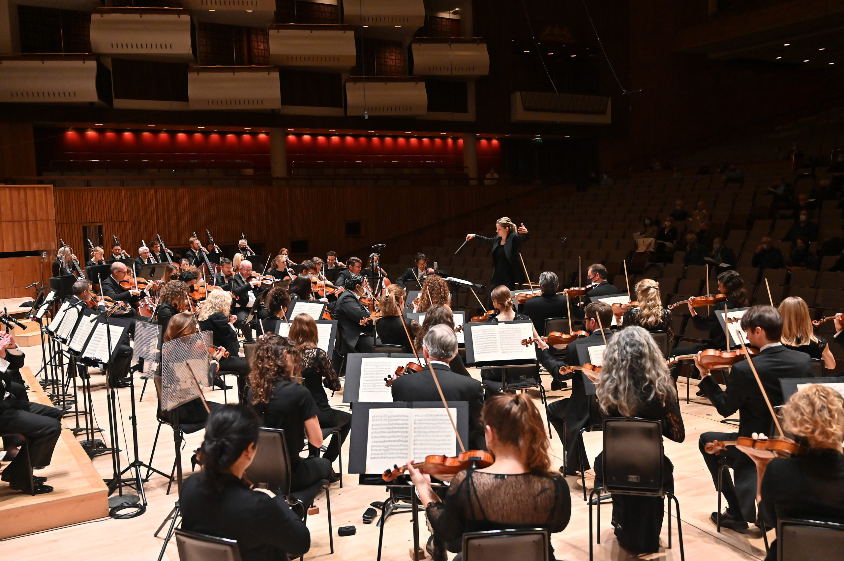
GCSE BrightSparks
Resources
BrightSparks is generously funded by the Rothschild Foundation with additional support from the Candide Trust, Dunard Fund, Rivers Foundation, Mrs Philip Kan, Gill and Julian Simmonds and Garfield Weston Foundation
© Rachel Leach and the London Philharmonic Orchestra 2024

Slide 2
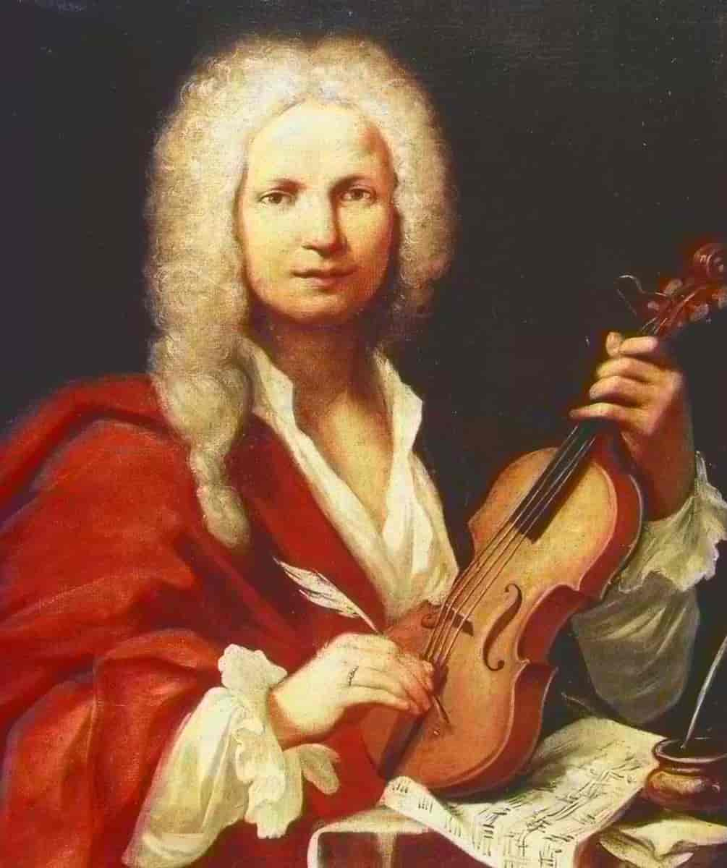
Antonio Vivaldi
(1678–1741)
‘Winter’: Movement I
The Four Seasons
(1718-1720)

Slide 3
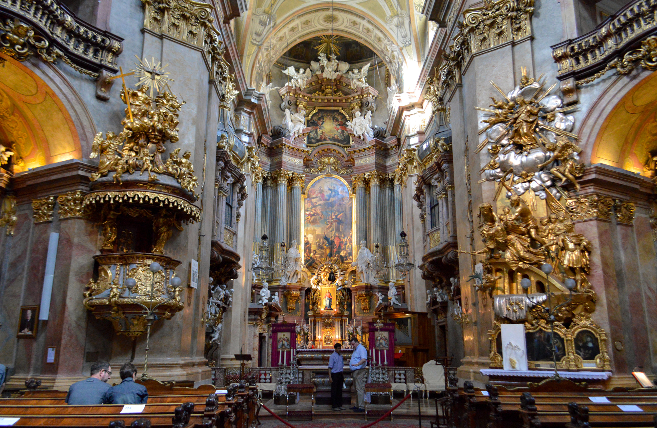
What is Baroque?
Baroque is a style of art, architecture, music, dance and literature which was popular in c. 1600 – 1750
It is characterised by exuberant colours, grandeur and flamboyance, and features lots of intricate ornamentation
An example of Baroque architecture

Slide 4
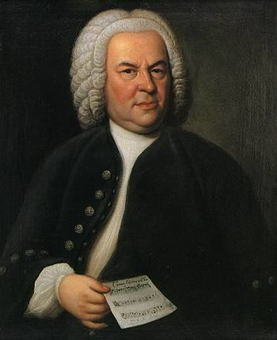
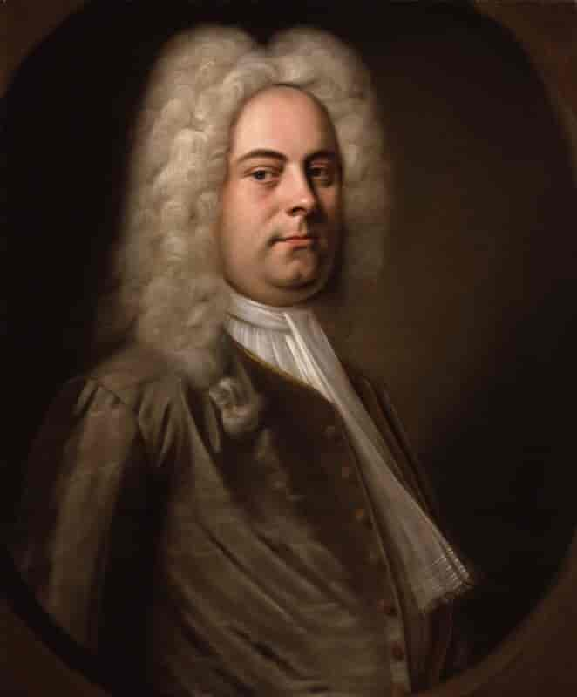
Some of the most important Baroque composers are…
Antonio Vivaldi
1678 – 1741
Italy
J.S. Bach
1685 – 1750
Germany
George Frideric Handel
1685 – 1759
England

Slide 5
Antonio Vivaldi (1678-1741)
Vivaldi was born in Venice in 1678
Throughout his career, he pioneered developments in orchestration, violin technique and program music
He also consolidated the form of the concerto, and helped it gain wider popularity
He composed many concertos, as well as sacred choral works and operas
Many of his works were written for the music ensemble at the Ospedale della Pieta, a home for abandoned children
In 1740 he went to Vienna in the hope of gaining royal support from Emperor Charles VI, but died in poverty less than a year later

Slide 6
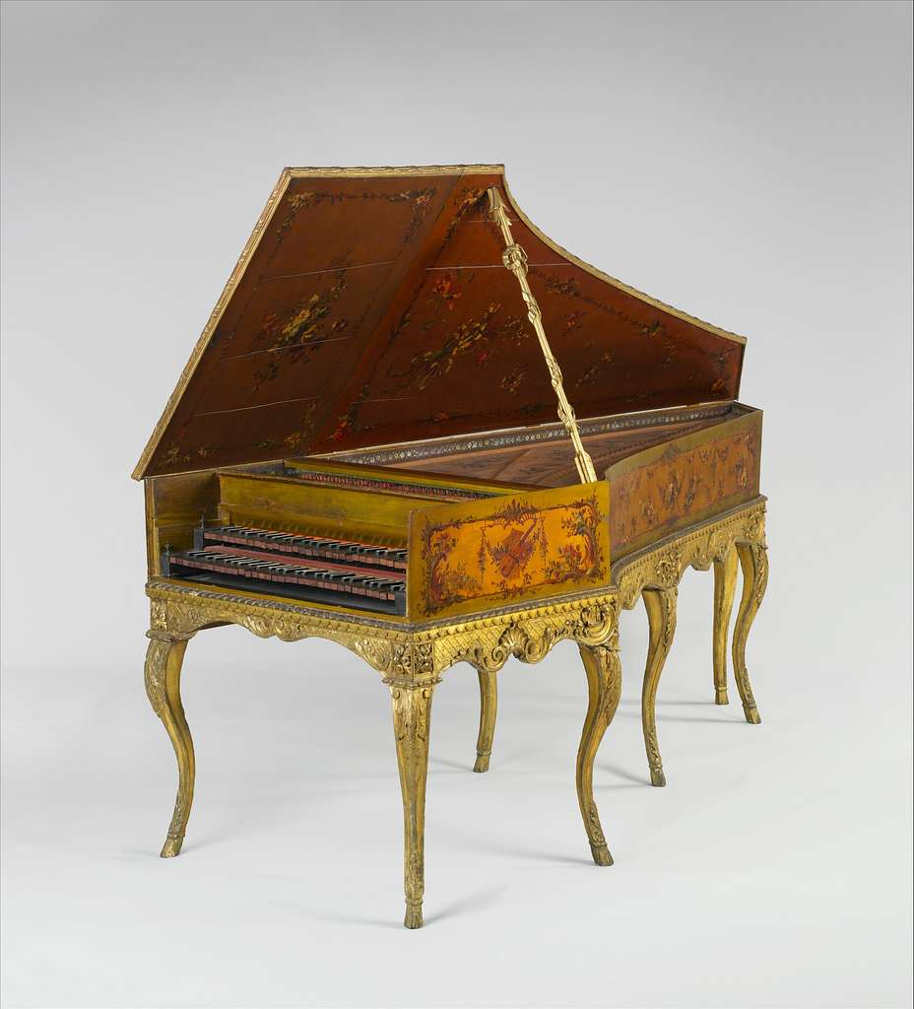
Key features of Baroque music:
Use of continuo
Baroque instruments, including the harpsichord
Frequent ornamentation, including trills, appoggiaturas (leaning note), mordents, turns, often improvised by the performer
Lots of repetition and sequences
Polyphonic textures are common
Continuo = improvised accompaniment of chords/harmony over bassline, played by harpsichord

Slide 7
Antonio Vivaldi
(1678–1741)
‘Winter’: Movement I
The Four Seasons
(1718-1720)

Slide 8
The Four Seasons
(1718-1720)
A group of 4 violin concertos
Each concerto represents a different season (Spring, Summer, Autumn, Winter)
Inspired by the Italian countryside – Vivaldi wrote them when he was working in a chapel in Mantua
Vivaldi wrote short poems describing the seasons, and then translated those poems into music
An early example of Program Music (music that tells a story or describes something) –unusual in the Baroque period

Slide 9
Program Music
Program music is music that tells a story or describes something non-musical
It is unusual for program music to take the form of a concerto, as it does in Vivaldi’s piece, and it is very unusual in Baroque music
Other examples of program music:
Symphonie fantastique by Hector Berlioz
The Sorcerer’s Apprentice by Paul Dukas
The Planets by Gustav Holst
Peter and the Wolf by Sergei Prokofiev

Slide 10
What is a concerto?
Concerto = a piece for soloist and orchestra
In the Baroque period (c.1650–1750), there were two main types of concerto:
Solo concerto = one soloist and orchestra
Concerto grosso = small group of soloists (concertino) and accompanying group (ripieno)
Which type of concerto is Vivaldi’s ‘Winter’?

Slide 11
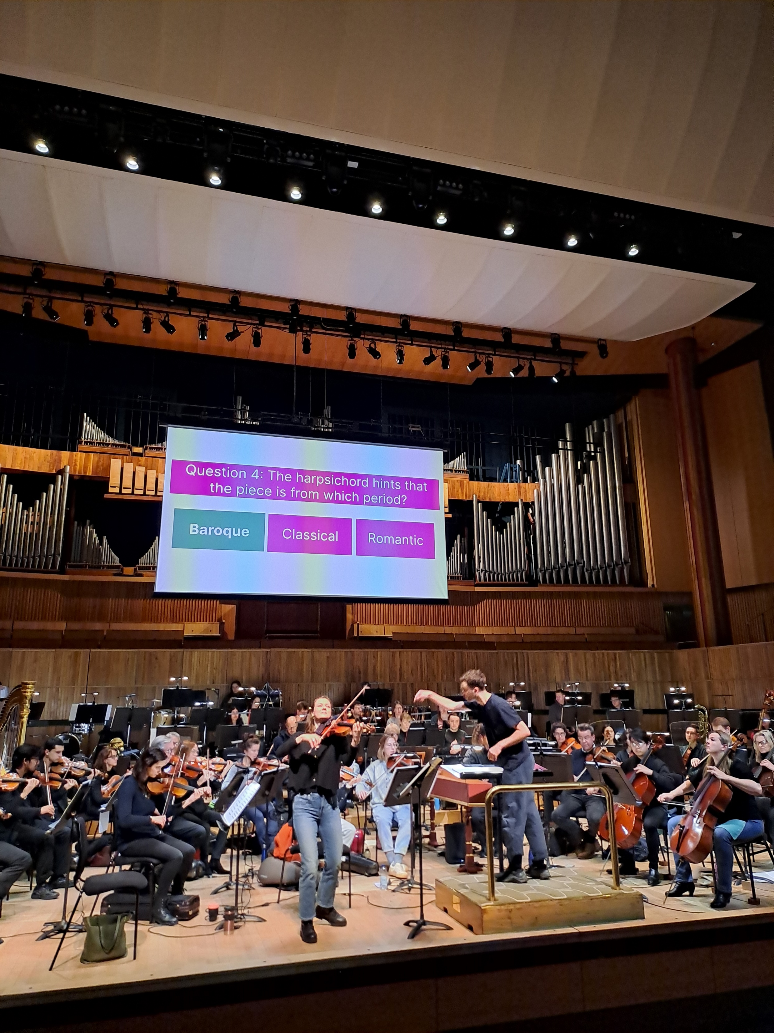
Solo concerto

Slide 12
The Four Seasons
(1718-1720)
Each concerto in ‘The Four Seasons’ has 3 movements
Movement 1 – Fast
Movement 2 – Slow
Movement 3 – Fast
Each concerto is based on a poem, written by Vivaldi himself

Slide 13
L’inverno (Winter)
Frozen and trembling in the icy snow,
In the severe blast of the horrible wind,
As we run, we constantly stamp our feet,
And our teeth chatter in the cold.
To spend happy and quiet days near the fire,
While, outside, the rain soaks hundreds.
We walk on the ice with slow steps,
And tread carefully, for fear of falling.
If we go quickly, we slip and fall to the ground.
Again we run on the ice,
Until it cracks and opens.
We hear, from closed doors,
Sirocco, Boreas, and all the winds in battle.
This is winter, but it brings joy.
Aggiacciato tremar tra neri algenti
Al Severo Spirar d’orrido Vento,
Correr battendo i piedi ogni momento;
E pel Soverchio gel batter i denti;
Passar al foco i di quieti e contenti
Mentre la pioggia fuor bagna ben cento
Caminar Sopra ‘l giaccio, e a passo lento
Per timor di cader gersene intenti;
Gir forte Sdruzziolar cader a terra
Di nuove ir Sopra ‘l giaccio e corer forte
Sin ch’il giaccio si rompe, e si disserra;
Sentir uscir dale ferrate porte
Sirocco Borea, e tutti i Venti in guerra
Quest’ é ‘l verno, ma tal, che gioja apporte.

Slide 14
Ritornello
In most of Vivaldi’s concertos, including this one, solo sections alternate with orchestral ones, to show the contrast between the two sounds
When the orchestra play, it’s called the Ritornello, which means ‘return’ i.e. the return to the full sound of the orchestra
The solo moments in between are called ‘episodes’

Slide 15
Bars 1-11: “Frozen and trembling in the icy snow…”

Slide 16
Bars 12-18: “In the severe blast of the horrible wind…”
First entrance of the solo violin, playing demisemiquaver arpeggios and scales
Each entry is higher than the last, so it is a sequence
Dominant chord of C minor

Slide 17
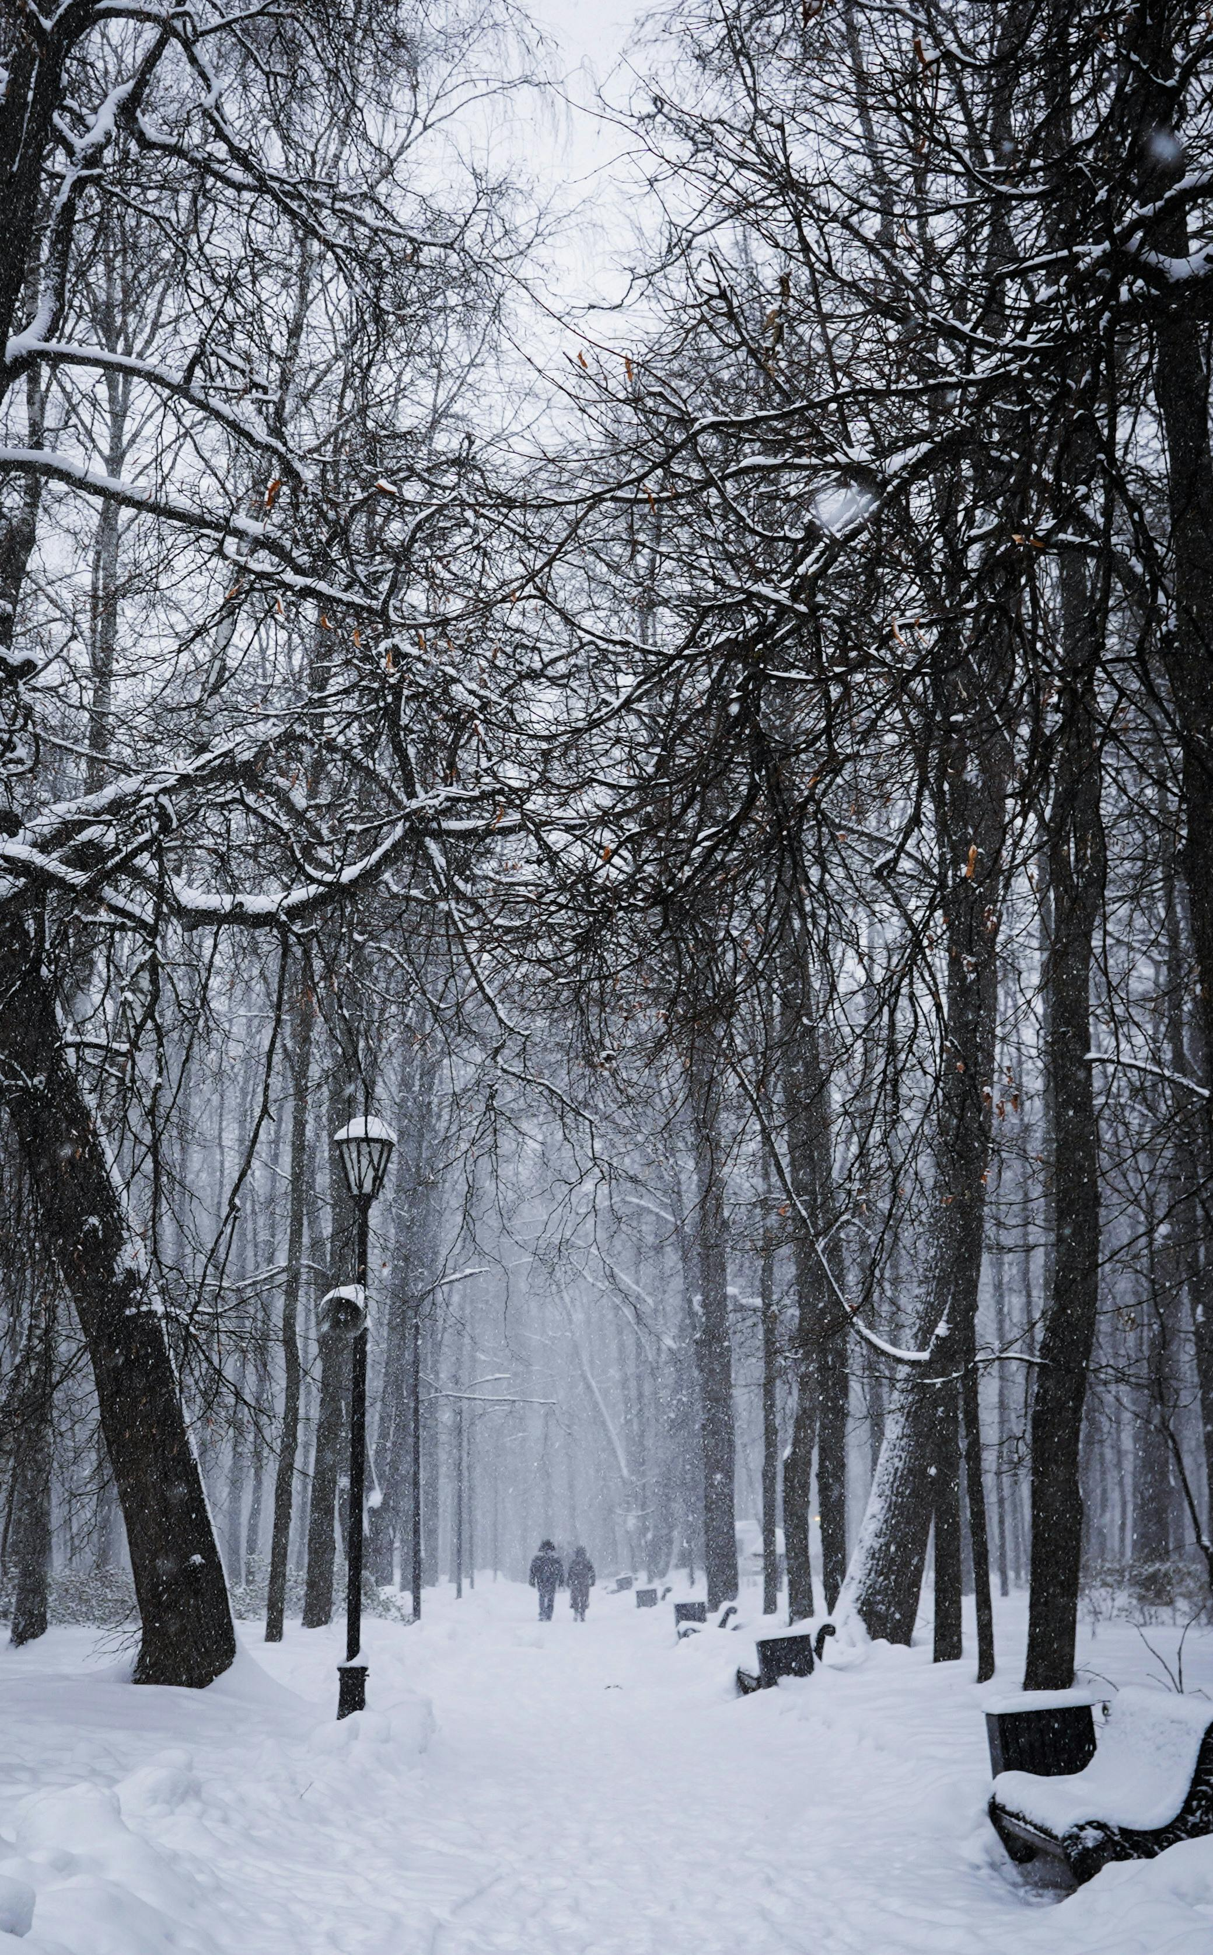
Bars 19-25: “As we run, we constantly stamp our feet…”
Second Ritornello section
Repeated semiquavers
F minor
Moves through cycle of fifths

Slide 18
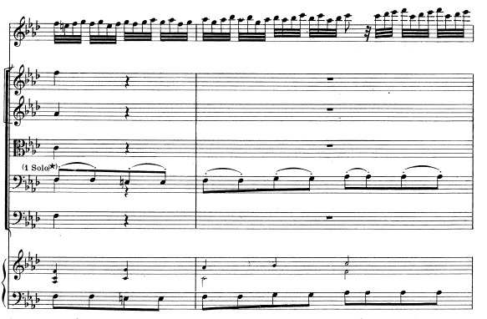
Bars 26-35:
26
Second solo Episode
Demisemiquaver scales
Another cycle of keys

Slide 19
Bars 33-38:
Rapid alteration between soloist and orchestra leads to…

Slide 20
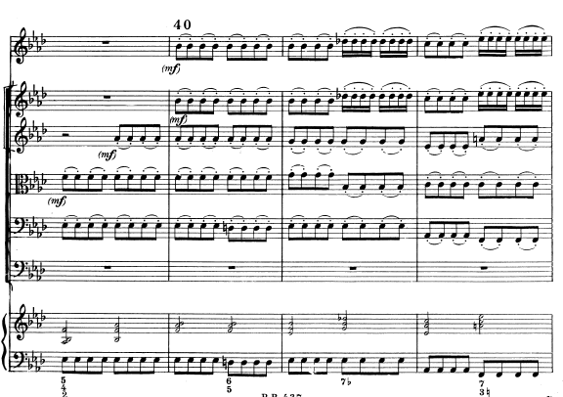
Bars 39-43:
Third Ritornello section
Returns to the original ‘stabbing’ chords from the beginning
Eb major

Slide 21
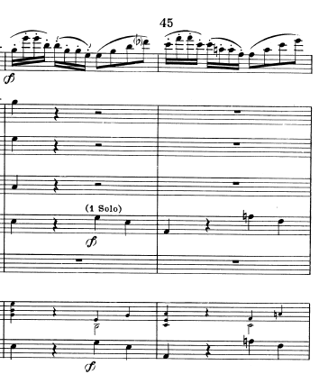
Bars 44-46:
Third Episode, beginning with a rising sequence
Another cycle of keys, moving from Eb major to C minor

Slide 22
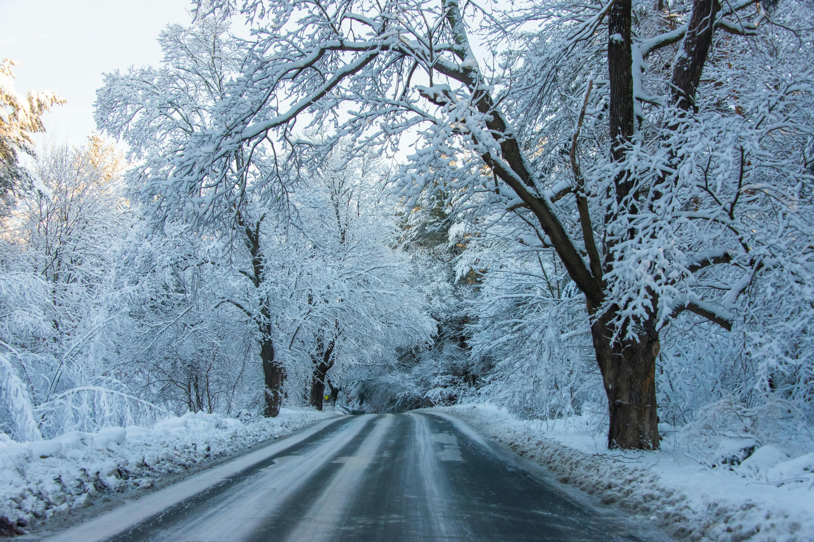
Bars 47-55: “And our teeth chatter in the cold…”
Bars 56-59:
Repeat of Ritornello 2
F minor (moves through cycle of fifths)

Slide 23
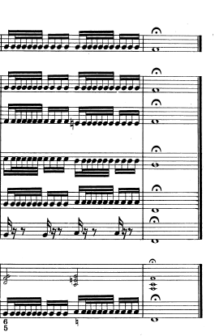
Bars 60-end: Coda
Coda = ending section
Perfect cadence: chord IV – V – I (twice) in home key of F minor
Cadence = final two chords of a phrase or section
IV
V
I

Slide 24
Further Listening: Baroque
The Four Seasons by Antonio Vivaldi
‘Badinerie’ from Suite No. 2 by J.S. Bach
Songs - Purcell’s ‘Music for a While’ and Handel’s ‘Rejoice Greatly’
George Frideric Handel’s Concerto Grosso Op. 6 No. 5
Bach’s ‘Brandenburg’ Concerto No. 5

